Slide 1
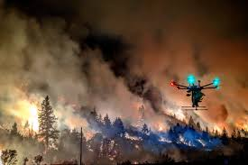
WildFire Detection and Tracking
Tech Crews:
A.Sree Lekha
A.Ushanjali
S.Sravani
M.Upagnya
V.Veera Swapna

Slide 2
Why we are doing this project….
Main motto for doing this Wildfire Detection and Tracking project is to detect and rapid response to wildfires, which is critical for minimizing the damage caused by these disasters.

Slide 3
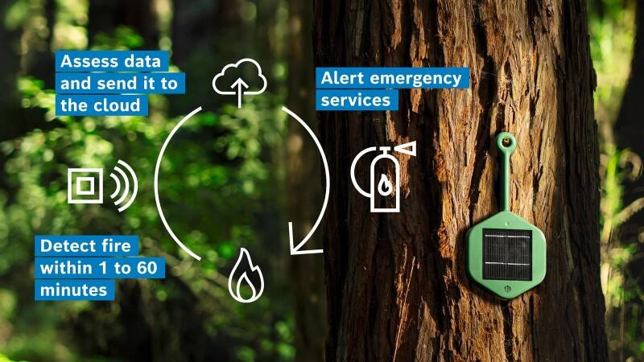
Problem Solution(Description)
Wildfire detection and tracking using AI is a system that uses AI algorithms to detect and monitor wild fires in real time. The system utilizes various data source such as satellite images weather data and ground sensors to identify the presence of wild fires.
One of the most common approaches for wildfire detection and tracking is to use machine learning algorithms to analyze satellite or aerial images in real-time. These algorithms can identify the location, size, and direction of the fire, as well as predict the likelihood of the fire spreading to nearby areas. This information can be used to guide firefighting efforts, evacuation plans, and resource allocation.

Slide 4
Business / Social Impact:
The use of Artificial intelligence (AI) in wildfire detection and ranging can have several positive social, Al-powered wildfire detection systems can help prevent the spread impacts.
Firstly, AI-powered wildfire detection systems can help prevent the spread of fires and minimize damage to property, infrastructure, and natural resources. By detecting fires earlier, emergency services can respond more quickly, reducing the risk of loss of life and property damage.
Secondly, Al can help improve the accuracy and reliability of wildfire detection, reducing false alarms and improving the efficiency of operations. This can lead to cost savings for emergency services and prevent unnecessary evacuations that can disrupt.
Finally Al-powered wildfire detection systems can also help raise public awareness about the risks and impacts of wildfires encouraging individuals and communities to take proactive steps to reduce the risk of fires and minimize their impact.

Slide 5
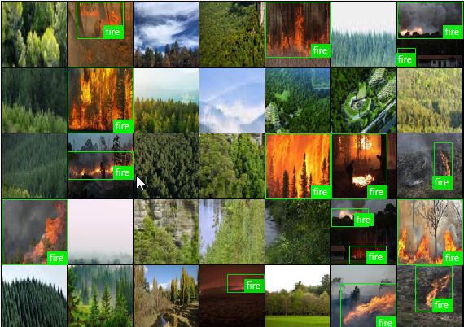

Slide 6
Technology Architecture:
The technology and stack for wild fire detection and ranging using AI typically includes the following components:
1. Data collection :
This involves collecting data from various source such as satellite imagery and weather stations, and other remote sensing devices. The data collected includes temperature, humidity, wind speed, and direction, as well as other relevant parameters.
2.Data processing and analysts:
This involves processing and analyzing the data collected using machine learning algorithms. This includes data cleaning, normalization, feature engineering, and other techniques to prepare the data for analysis.

Slide 7
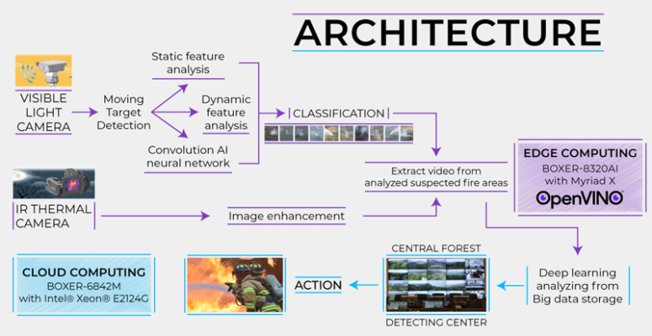
3. Geographic information Systems (GIS):
GIS is used to visualize the data and provide location based information on the wildfire's location, spread and intensity.

Slide 8
Scope of the Work:
The scope of a work for wild fire detection and ranging using can be divided into several stages including :
1. Model training using Machine learning algorithms such as neural networks or decision trees to train a model on the extracted features to identify wildfire events accurately.
2 Real-time monitoring Deploying the trained model in real-time to continuously monitor the data streams for the occurrence of a wildfire event.
3. Alerting relevant authorities, such as fire departments or emergency services, when a wildfire is detected. including the location and severity of the fire.
4 Visualization Visualizing the detected wildfire on a map, including the fire's spread over time, to aid in decision- making and resource allocation

Slide 9
Conclusion:
Wildfire will continue to affect source water quality resulting to increasing treatment, maintenance and operating costs. Therefore, forest and watershed managers and water suppliers have to be well informed about wildfire impacts so as to develop mitigation strategies to build resiliency to wildfire in water supply.

Slide 10


